Slide 1


Stock Price Prediction
Atharv Sathe (20104054)
Mihir Shrivas (20104081)
Jayesh Singh (20104101)
Harsh Yadavade (20104077)
Project Guide
Prof. Sneha Dalvi
01

Slide 2
Contents
Introduction
Objectives
Scope
Features / Functionality
Project Outcomes
Technology Stack
Project Design
Conclusion
References
02

Slide 3
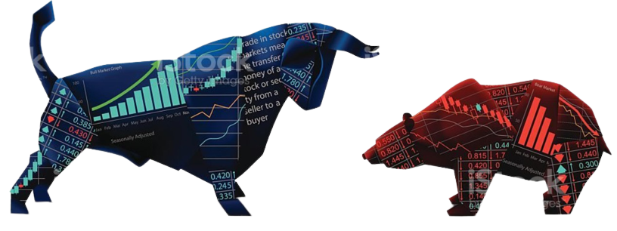
What is Stock Market ?
03

Slide 4
Introduction
Stock Price prediction is the act of determining the future value of a company stock or other financial instrument traded on an exchange. The successful prediction of a stock's future price could yield significant profit to the investors.
With the development of the stock market, people are interested in forecasting stock price
Ability to predict directions of stock prices accurately is crucial for market dealers or investors to maximize their profits.
Stock Price Variation uses - Demand & Supply strategy.
Prediction of share markets is challenging task. Because , its randomness in nature.
The share price movement over a long period of time usually develops a linear curve . People tend to buy those stocks whose prices are expected to rise in the near future.
04

Slide 5
Problem Identified :
The challenge of this project is to predict the future closing value of a given stock across a given period of time .
Investors requires graphs and statistical figures to identify the trends in the stock market.
Solution Proposed:
Our focus will be on the technical analysis and visualization part ,which consist of graphs and statistical figures.
We propose an online learning algorithm for predicting the end-of-day price of a given stock with the help of Long Short Term Memory (LSTM), a type of Recurrent Neural Network (RNN).
For this project we will be using Long Short Term Memory networks – usually just called “LSTMs” to predict the closing price using a dataset of past prices.
05

Slide 6
Objectives
In the current emerging competitive market, predicting the stock returns as well as the company's financial status in advance will provide more benefits for the investors in order to invest confidently.
The primary objective is to predict an approximate value of share price.
The project target is to create an application that analyses previous stock data of companies and implement values using LSTM to determine the value that particular stock will have in near future with suitable accuracy.
This project is intended to solve the economic dilemma created in individuals that wants to invest in stock market .
To provide analysis for users through web application
Through this application users can identify the factors affecting the price of the share market
This application generate the pattern from large set of data of stock market for prediction od BSE & NSE.
06

Slide 7
Scope
The main aim is to build an application in such a way that it will provide a platform where a stock price prediction of all the companies under BSE& NSE will display.
Analysis of stocks using LSTM will be useful for new investors to invest in stock market based on various factors such as Exchange Rates , Interest Rates, etc…..considered by the software.
This application comparatively analyze the effectiveness of prediction algorithms on stock price prediction and get general insight on this data through visualization to predict future stock behavior and value at risk for each stock
This application uses LSTM method to predict future stock returns based on past return.
07

Slide 8
Features
Feature 1: Authentication for different investors
Feature 2: Providing Personalized Watchlist
Feature 3:Latest Updates on Prices of BSE & NSE
Feature 4: History of Stocks records in database
08

Slide 9
Outcomes of Project
Determining the Stock market forecast is always been challenging work for analyst.
The Opening Value of the stock, the Highest and Lowest values of that stock on the same days, as well as the Closing Value at the end of the day, are all indicated for each date through scrapping.
Predicting the stock market was a time-consuming and laborious procedure a few years or even a decade ago. However, with the application of LSTM for stock price prediction forecasts, the procedure has become much simpler.
09

Slide 10
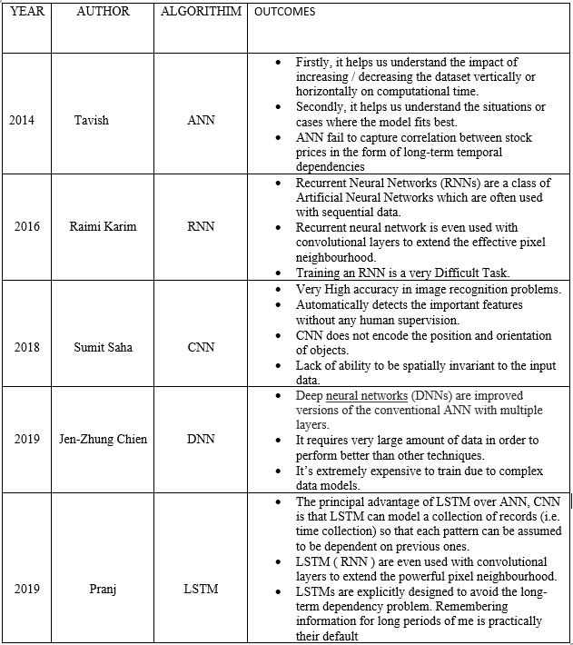
Literature Survey
Figure a :- Literature Survey Table 10

Slide 11
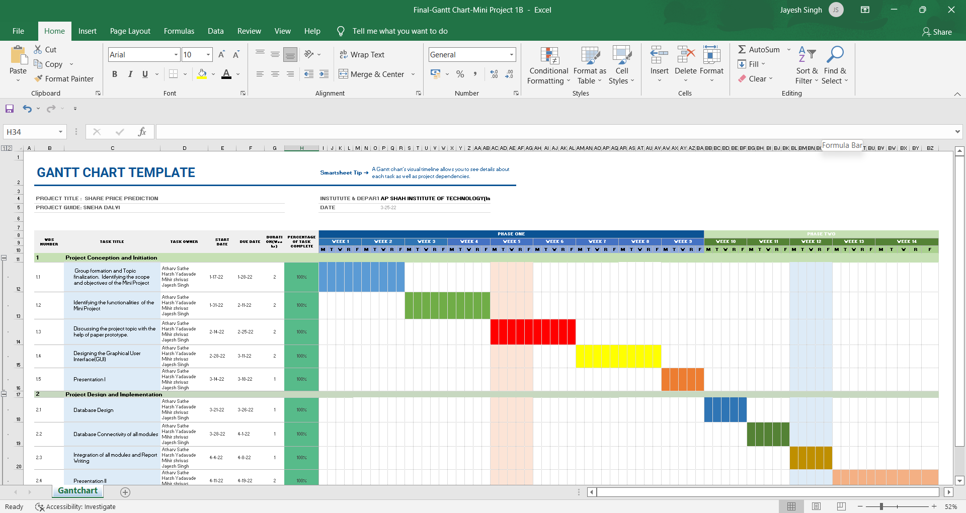
GANTT CHART
https://drive.google.com/drive/folders/1VIEf1ysJQ-QqYykrd3l-uebYSAW-iuvs
11

Slide 12
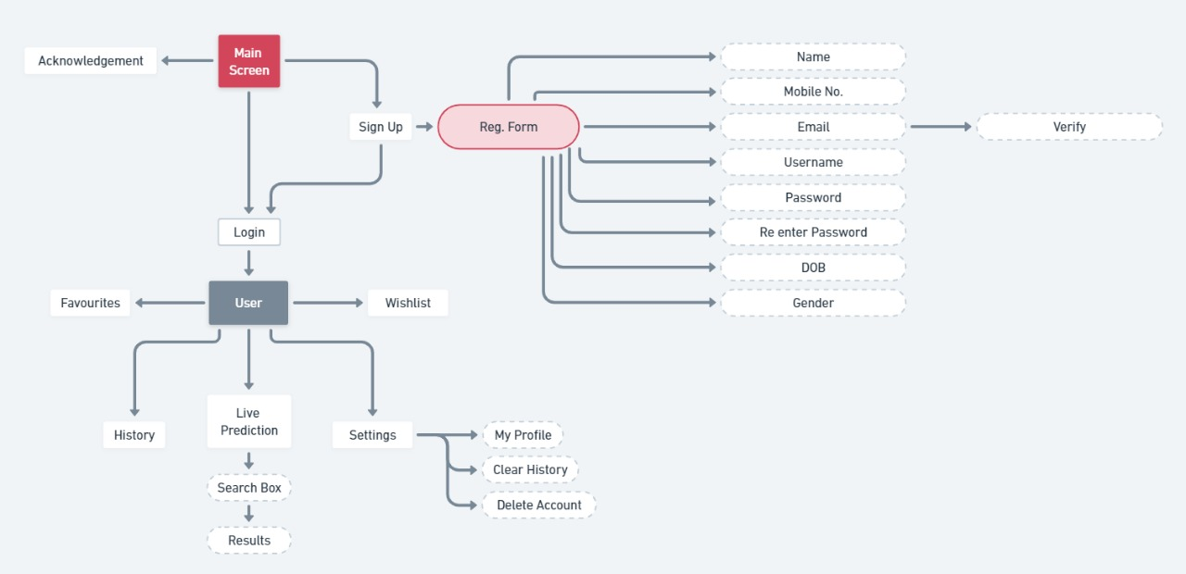
Flow Chart
https://drive.google.com/drive/folders/1VIEf1ysJQ-QqYykrd3l-uebYSAW-iuvs
12

Slide 13
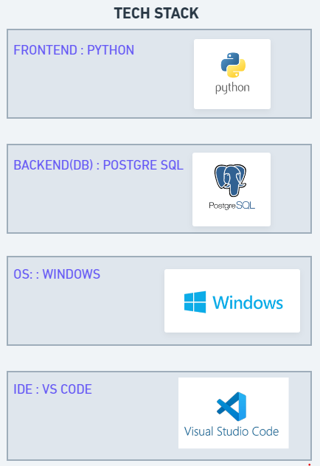

Technology Stack
Fig : Technology Stack 13

Slide 14
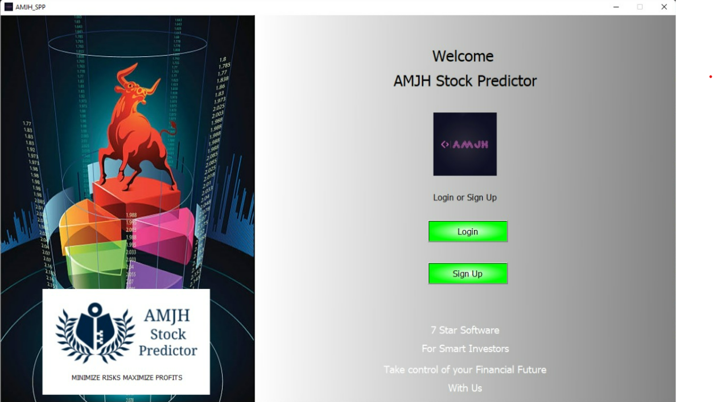
Implementation
Figure1: Welcome Screen Page
14

Slide 15
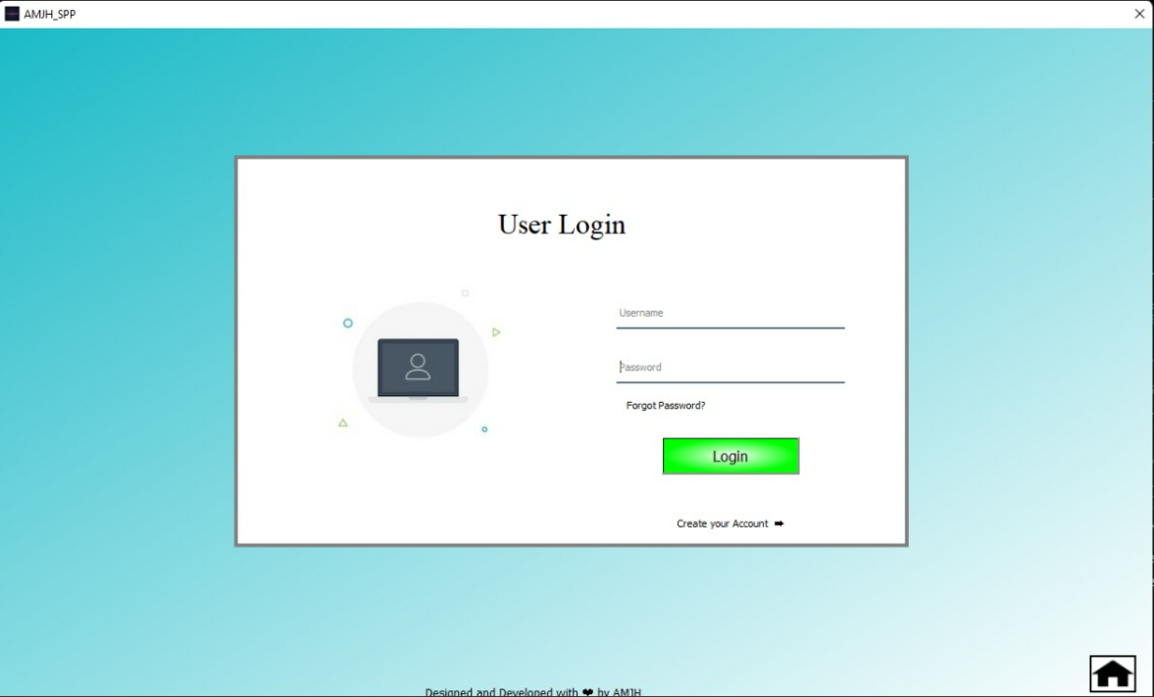
Figure 2: Login Page
15

Slide 16
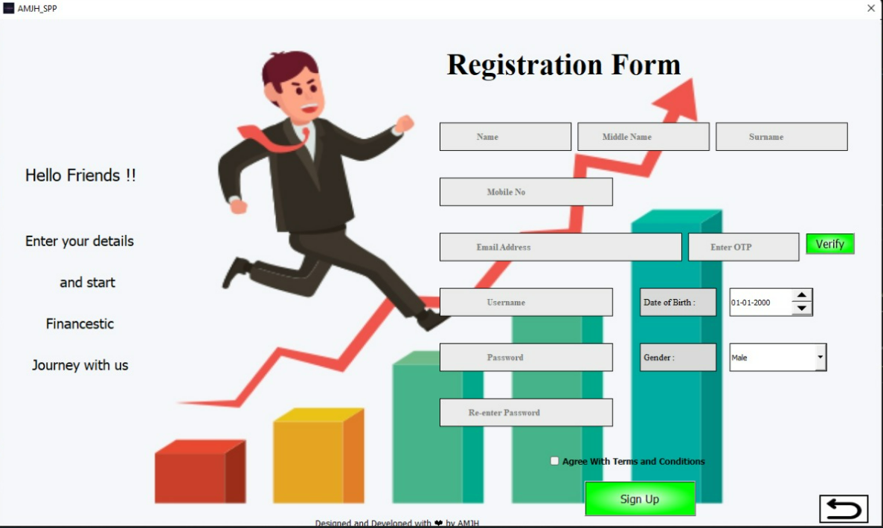
Figure 3: Signup Screen
16

Slide 17
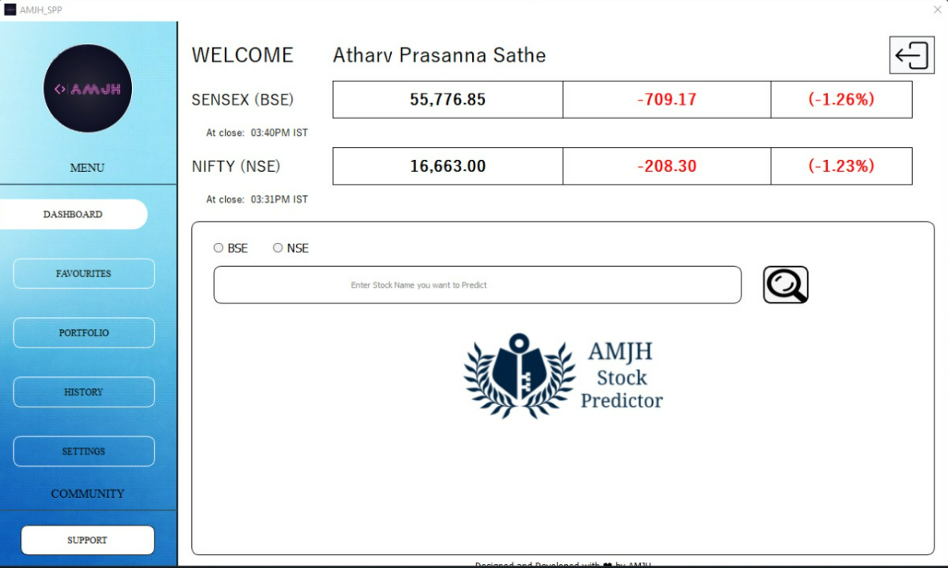
Figure 4: Dashboard (Main Page)
17

Slide 18
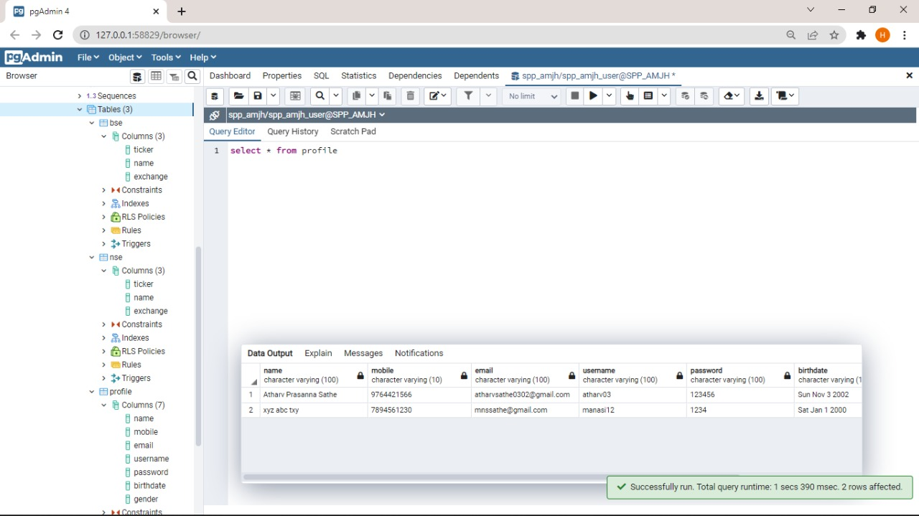
18
Figure 5: Database Login Table

Slide 19
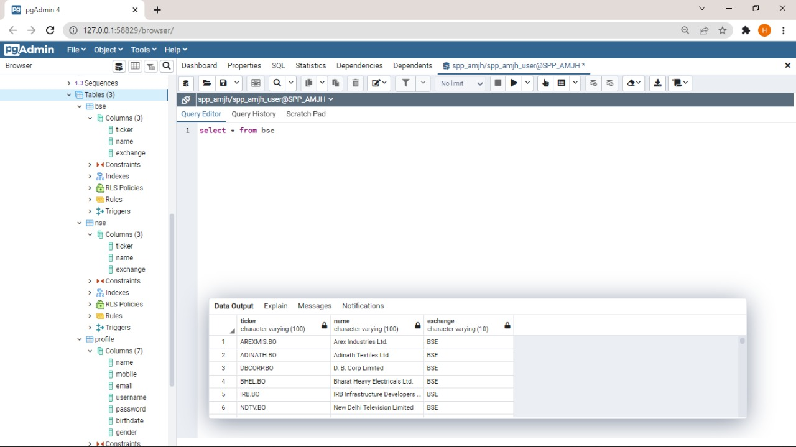
19
Figure 6: Database Tickers Table
(BSE)

Slide 20
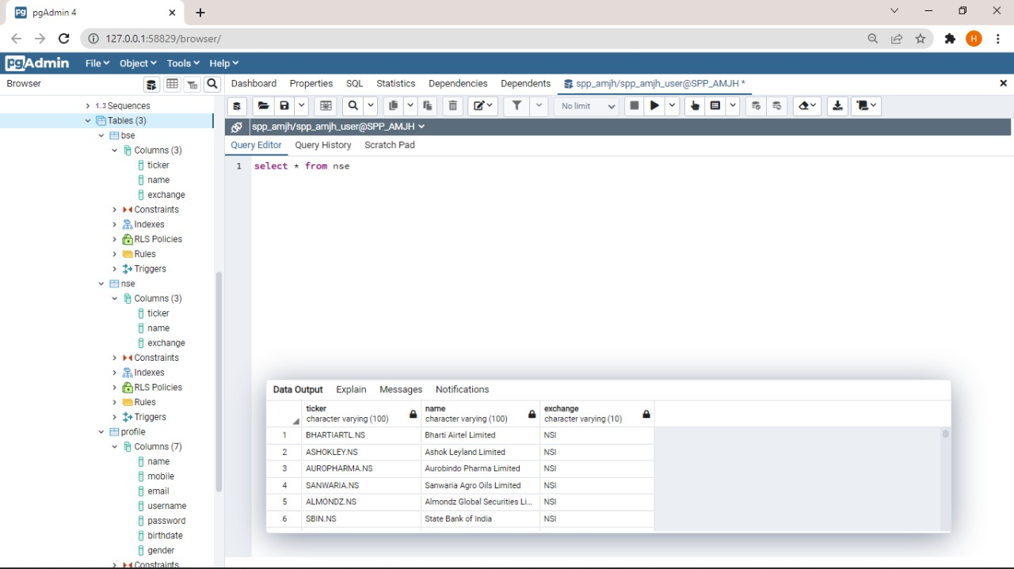
Figure 7: Database Tickers Table
(NSE)
20

Slide 21
Conclusion
This application helps investors to understand the idea of current market value and future stock behaviors.
The project covers the successful development of a GUI along with database connectivity with PostgreSQL.
The Project is based on the Sequential machine learning model to predict the prices which we have achieved using LSTM (Long-Short-Term-Memory) for prediction of Shares.
Based on predicted value graphs has been plotted using Matplotlib Library.
21

Slide 22
References
[1] towardsdatascience.com/predicting-stock-prices-with-python-ec1d0c9bece1
[2] irjet.net/archives/V5/i5/IRJET-V5I5393.pdf
[3] analyticsvidhya.com/blog/2014/10/ann-work-simplified
[4] ieeexplore.ieee.org/document/7839671
[5] docs.python.org/3
[6] geeksforgeeks.org/python-programming-language
[7] data-flair. Training/blogs/stock-price-prediction-project-in-python
[8] askpython.com/python/examples/stock-price-prediction-python
[9] https://www.irjet.net/archives/V5/i5/IRJET-V5I5393.pdf
22

Slide 23
THANK YOU!!!!
23

